Slide 1
MSc Project (CMP060L050S) Mid-Point Review Presentation Enhancing English-to-Tamil Neural Machine Translation
Student Name : SASIKUMAR KARUPPANNAN
Supervisor Name: KARIM BOUZOUBAA

Slide 2
Outline
context​
problematic statement​
objectives ​
methodology​
project management​
literature review​
next steps

Slide 3
context
Language translation involves converting text or speech from one language to another, enabling communication across linguistic boundaries. It is a critical technology for facilitating global interaction, bridging cultural gaps, and providing access to information for speakers of different languages.
Machine Translation (MT) uses software to automatically translate text or speech between languages. It's essential for global communication, accessibility, and efficiency, allowing quick translations of large texts. MT promotes cross-cultural understanding, supports low-resource languages like Tamil, and enhances real-time multilingual interactions in business and daily life.

Slide 4
Current Situation of English-Tamil Translation
Today, English-Tamil translation faces challenges due to the complexity of Tamil's syntax and rich vocabulary. However, advancements in Neural Machine Translation (NMT) have significantly improved translation quality. Efforts are ongoing to enhance datasets and refine algorithms, making translations more accurate and accessible for Tamil speakers globally.

Slide 5
eXisting dataset and models for English to tamil MT
DATASET
OPUS (Open Parallel Corpus)
OPUS100
IndicNLP Corpus
Global Voices
…
MODELS
MT5
Google Neural Machine Translation (GNMT)
mBART (Multilingual BART)
T5 (Text-to-Text Transfer Transformer)
…

Slide 6
PROBLEM STATEMENT -why
There are advancements in natural language processing(NLP). However:
Inadequate performance of existing machine translation systems, particularly in accurately translating between English and Tamil
MT into Tamil often suffers from errors in syntax, semantics, and cultural context

Slide 7
OBJECTIVE - what
Develop a Machine Translation system that improves English-to-Tamil translations by fine-tuning language models, ensuring high-quality output and supporting effective communication for Tamil-speaking users.
IMPACT:
It emphasizes the need to overcome linguistic challenges inherent to Tamil, thereby facilitating better cross-linguistic communication and promoting inclusivity in digital content accessibility for Tamil-speaking communities.

Slide 8
METHODOLOGY - how
Data Collection and Preparation
Model Selection
Training Process
Evaluation
Model Deployment(Optional)
Iterative Improvement

Slide 9
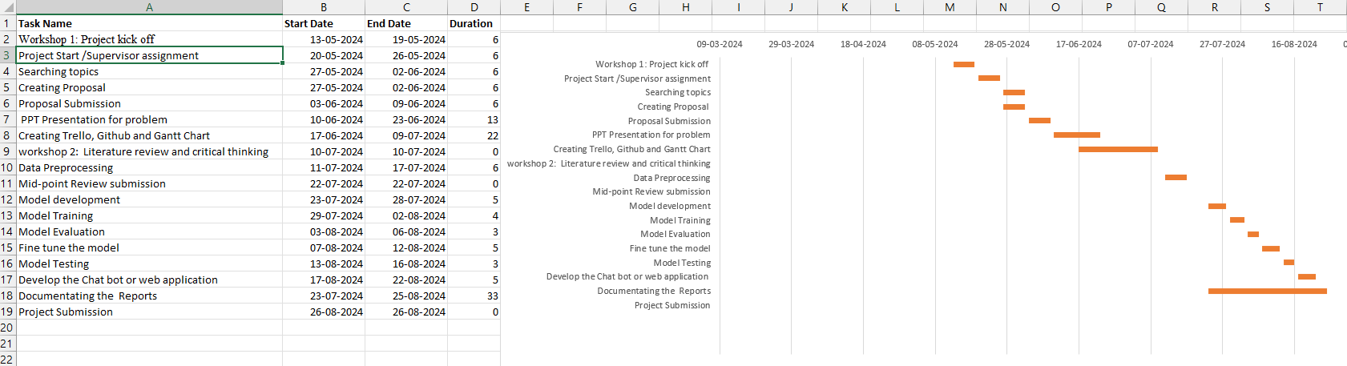
Project Management
Gantt Chart

Slide 10
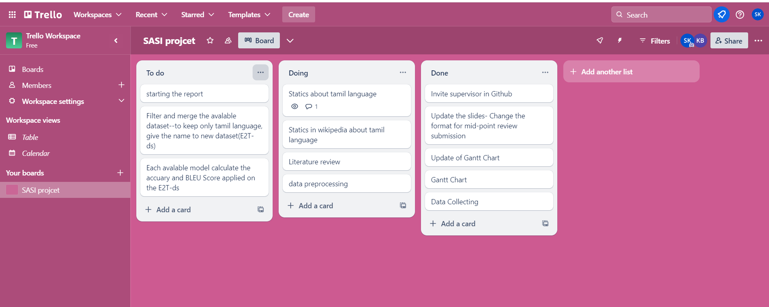
Trello setup

Slide 11
Literature review
1.Evolution of Translation Technologies:
Transitioned from rule-based systems to statistical models, and then to neural machine translation (NMT),
which offers superior accuracy and fluency.
2.Large Language Models (LLMs):
Advanced models like BERT, GPT-3, and mBART have significantly improved translation quality through
extensive pre-training on diverse datasets.
3.Challenges with Low-Resource Languages:
Tamil faces data scarcity and linguistic complexity, making accurate translation difficult.
4.Innovative Approaches:
Techniques like transfer learning, fine-tuning pre-trained models, and data augmentation help improve
translation for low-resource languages.
5.Significance:
Addressing these challenges is crucial for enhancing communication, education, and information access for
speakers of low-resource languages.

Slide 12
Next Steps
Realized Progress
Research and Planning, Dataset Acquisition, Model Selection and Preliminary Training
Remaining Tasks
Fine-Tuning, Model Evaluation and Testing, User Testing and Feedback, Final Adjustments and Basic Deployment
Mastering Progress:
Currently on track with all milestones.
Regular updates and evaluations are conducted to ensure alignment with goals.

Slide 13
THANK YOU

